Slide 1
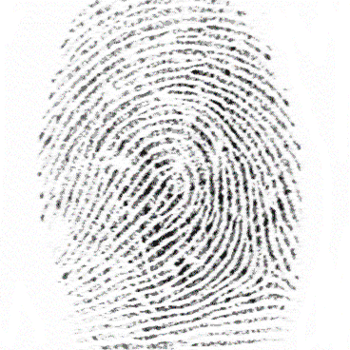

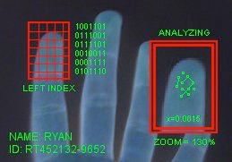
Fingerprint Recognition

Slide 2
Definition
Biometrics: identifying/authenticating an individual in an automated, reliable and fast way using unique physiological or behavioral characteristics
Physiological: static
morphometric (shape): face
biological: DNA
Behavioral: dynamic
the way we walk, speak, write
https://www.gemalto.com/govt/inspired/biometrics#
Faculty of Engineering Sciences, ESAT-PSI

Slide 3
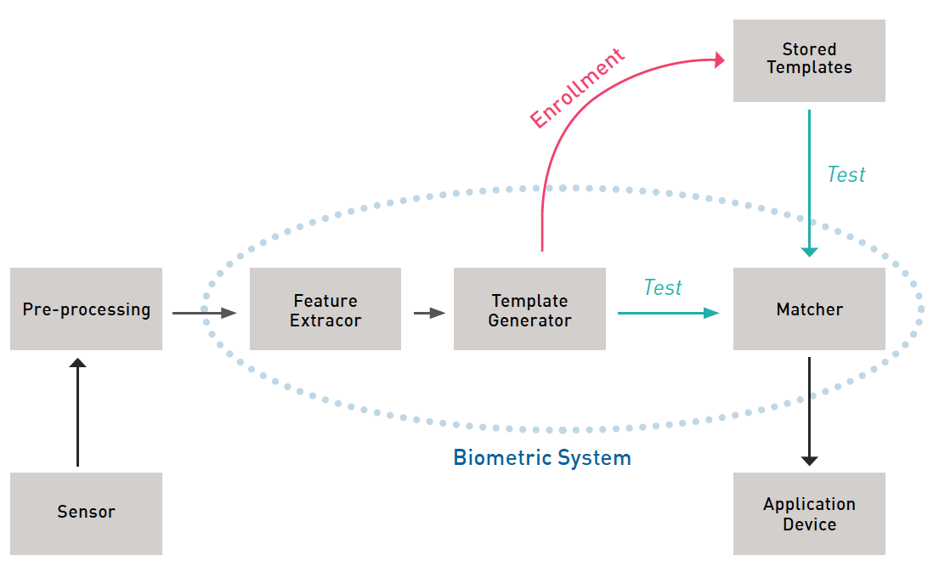
Biometrics Syllabus
PART I BACKGROUND
Introduction
Basic pattern recognition aspects
Part II APPLICATIONS
fingerprints
facial recognition
iris scanning
retina scanning
hand geometry
voice verification
signature verification
Others (ear biometrics)
Multi-modal biometrics
Part III Implementation and security issues

Slide 4
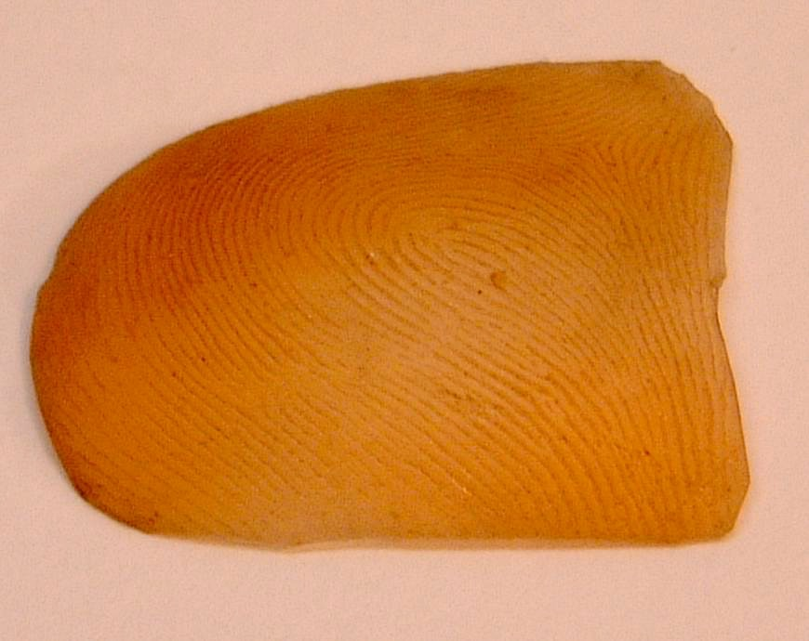
Fingerprint: what
Fingerprint = pattern of flow-like ridges and valleys on the surface of a fingertip
Fingerprint shape is determined during fetal period, depending on the initial conditions of the embryonic mesoderm.
Fingerprints of identical twins are different
No (detail) correlation between prints of different fingers of the same individual
Notes:
[Lucian Rila/RHUL]
Fingerprint is the mother biometric and the most widely used biometric. The advent of several inkless fingerprint scanning technologies coupled with the exponential increase in processor performance has taken fingerprint recognition out of the criminal identification applications to several civilian applications such as access control; time and attendance; and computer user login.

Slide 5
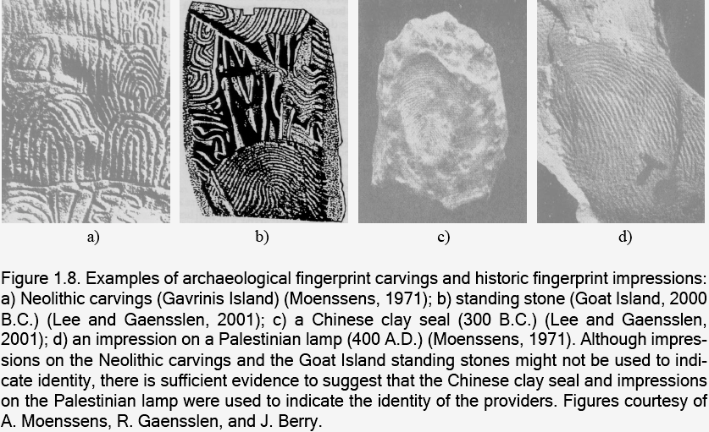
Ancient fingerprints
Notes:
From Handbook of Fingerprint Recognition, by Davide Maltoni (Editor), Dario Maio, Anil K. Jain, Salil Prabhakar :
Human fingerprints have been discovered on a large number of archaeological artifacts and historical items (see Figure 1.8 for some examples). Although these findings provide evidence to show that ancient people were aware of the individuality of fingerprints, such awareness does not appear to have any scientific basis.

Slide 6
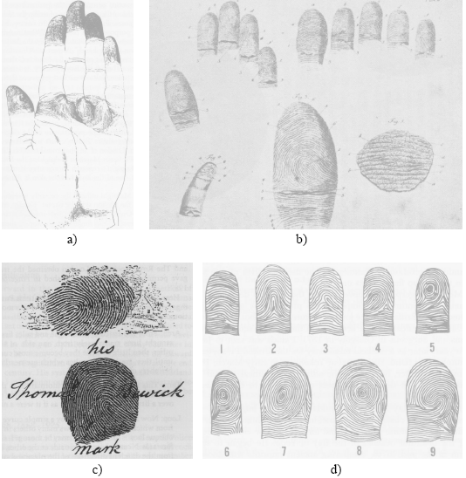
Scientific Fingerprint studies
Dermatoglyphics drawn by Grew (1684);
Mayer’s drawings of fingerprints (1788);
Trademark of Thomas Bewick (1806);
The nine patterns illustrated in Purkinje’s thesis (1823);
Sir Francis Galton: minutiae (1892);
Edward Henry: Henry classification (1899)
Notes:
It was not until the late sixteenth century that the modern scientific fingerprint technique was first initiated. In 1684, the English plant morphologist, Nehemiah Grew, published the first scientific paper reporting his systematic study on the ridge, furrow, and pore structure in fingerprints

Slide 7
Fingerprint characteristics
The first legally accepted, readily automated and mature biometric technique
Most understood and studied biometric
Used for a long time : identification studies started late 19th century (FBI 1924: 810K FP cards)
Validity well-established ((FBI,1995): 200 million FP cards (10 fingers))
Daily requests (10K/day) for FPR necessitate automation
AFIS (Automatic Fingerprint Identification Systems) installed (since 1960s) in law enforcing agencies worldwide, continued to IAFIS (Integrated AFIS) maintained by FBI
The success of AFIS led to incorporation in civilian applications
With solid state sensors => incorporation in many applications
Acceptability? Because of association with criminal investigations
https://www.bayometric.com/afis-vs-iafis/

Slide 8

Fingerprint Recognition System
Faculty of Engineering Sciences, ESAT-PSI

Slide 9
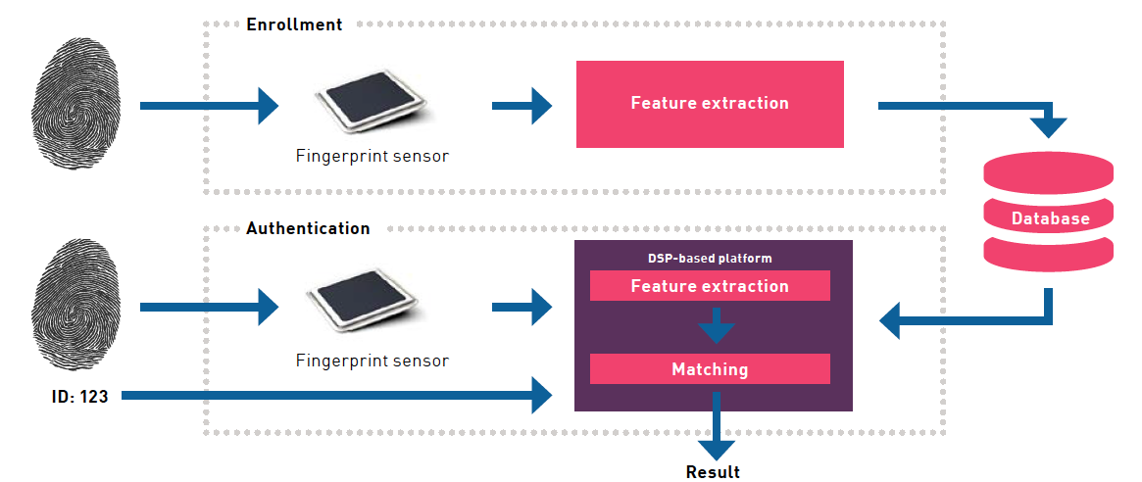
Fingerprint Recognition System
https://www.fingerprints.com

Slide 10
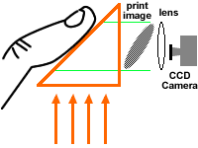
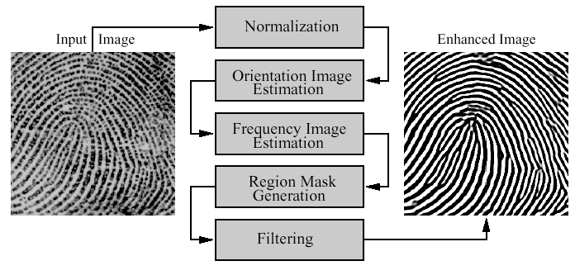
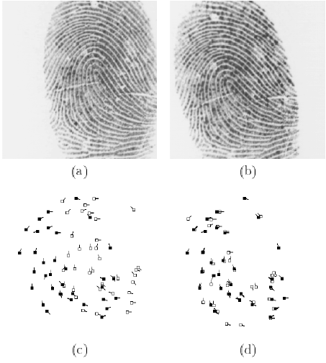
Overall Design of Fingerprint Recognition Systems
Acquisition
Enhancement
Representation/feature extraction
Feature matching

Slide 11
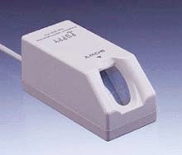
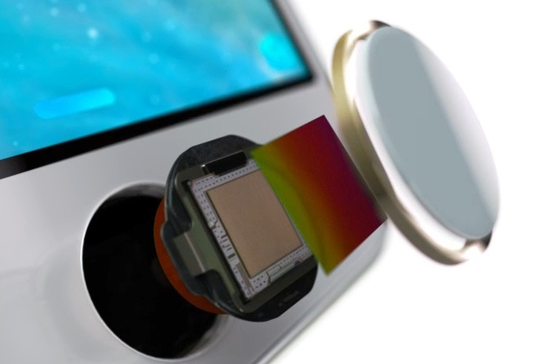
Fingerprint Acquisition

Slide 12
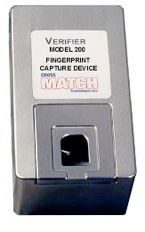
Acquisition of Fingerprints
Inked fingerprints (off-line).
Impression of inked finger on paper.
Image scanned (using flat bed scanner).
Cumbersome.
Infeasible and socially unacceptable for identity verification.
Latent fingerprints on crime scenes.
Live scan (ink-less).
Image directly obtained without paper impression.

Slide 13
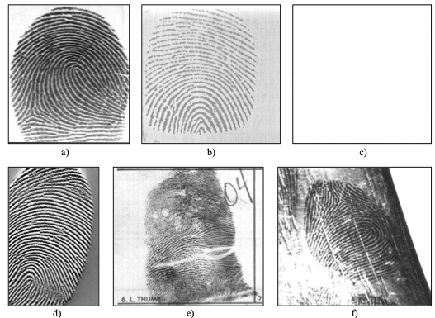
Fingerprint Examples
Live-scan optical scanner
Live-scan capacitive scanner
Live-scan piezoelectric scanner
Live-scan thermal scanner
Off-line (rolled) inked impression
Latent fingerprint

Slide 14
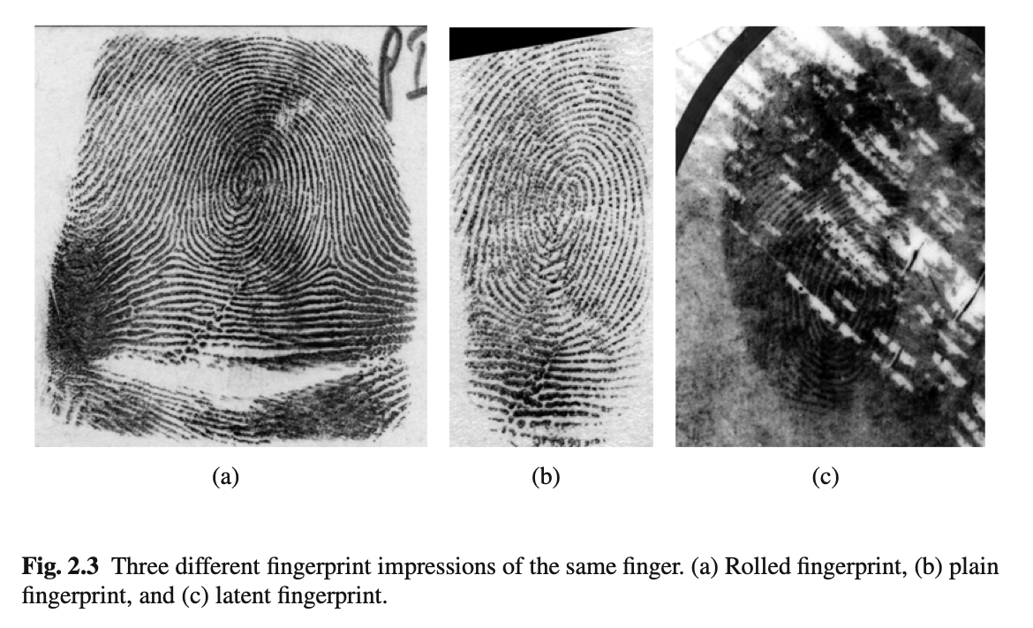
Same finger, different FP

Slide 15
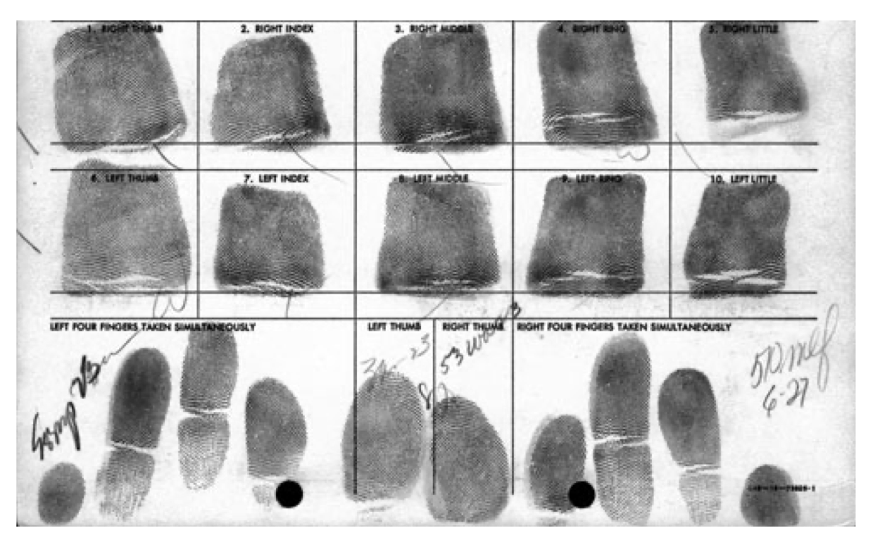
Inked fingerprints

Slide 16
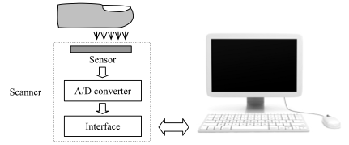
General structure of FP live-scan device
Faculty of Engineering Sciences, ESAT-PSI

Slide 17
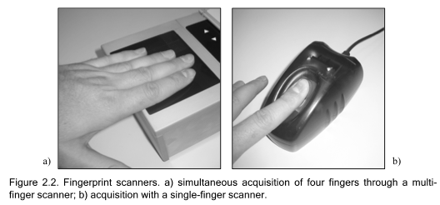
Multi-finger and single-finger acquisition
Faculty of Engineering Sciences, ESAT-PSI

Slide 18
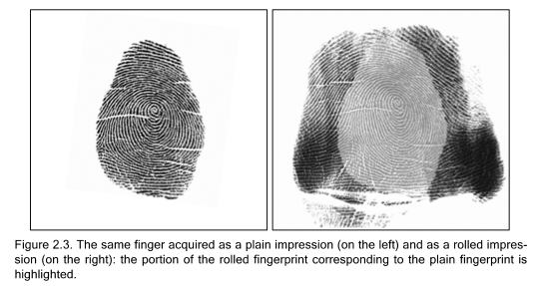
Rolled versus dab
Faculty of Engineering Sciences, ESAT-PSI

Slide 19
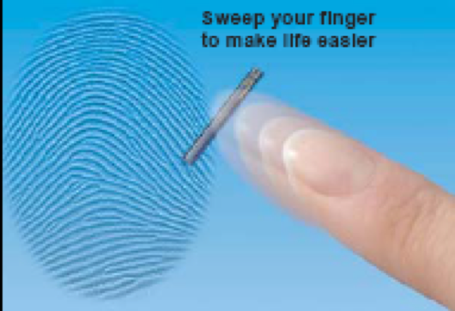
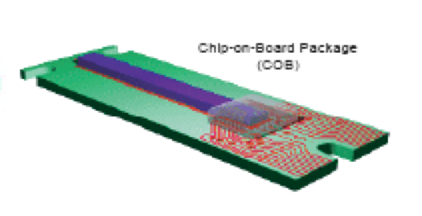
Sweeping
Atmel Corp.

Slide 20
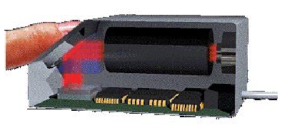
Live-scan Devices: Optical
Optical Frustrated Total Internal Reflection (FTIR)
Ó I/O software
the rays incident at the ridge/glass interface scatter
the rays incident at the valley/glass interface suffers total internal reflection
the reflected rays are collected at the imaging surface
Notes:
[Jain & Pankanti:]
Over the last decade, many novel techniques have been developed to acquire fingerprints without the use of ink. These scanners are known as the “livescan” fingerprint scanners. The basic principle in these inkless methods is to sense the ridges and valleys on a finger when the finger is in contact with the surface of the scanner.
The most popular technology to obtain a live-scan fingerprint image is based on the optical frustrated total internal reflection (FTIR) concept [18]. When a finger is placed on one side of a glass platen (prism), ridges of the finger are in contact with the platen, while the valleys of the finger are not in contact with the platen. The rest of the imaging system essentially consists of an assembly of an LED light source and a CCD camera placed on the other side of the glass platen. The laser light source illuminates the glass at a certain angle and the camera is placed such that it can capture the laser light reflected from the glass. The light which is incident on the plate at the glass surface touched by the ridges is randomly scattered while the light incident at the glass surface corresponding to valleys suffers total internal reflection, resulting in a corresponding fingerprint image on the imaging plane of the CCD. An example of live-scan fingerprint is shown in Figure 4 (b). Figure 5 shows a FTIR fingerprint scanner. Typically, an optical live-scan fingerprint scanner images span an area which is approximately

Slide 21
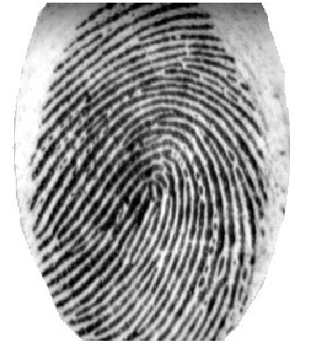
Live-scan Devices: Optical
+ Oldest and most commonly used (law enforcement)
+ relatively low cost
+ Generally superior quality
+ Potentially larger sensing areas
- Problems with latent fingerprints
+ Cannot be fooled with 2D picture
Bulky (optical path), can not be miniaturized
Ó Biometric Access Corporation

Slide 22
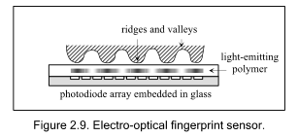
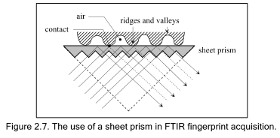
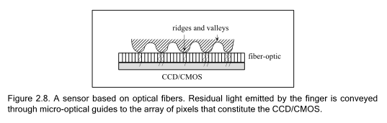
Live-scan Devices: Optical: smaller alternatives
Faculty of Engineering Sciences, ESAT-PSI

Slide 23
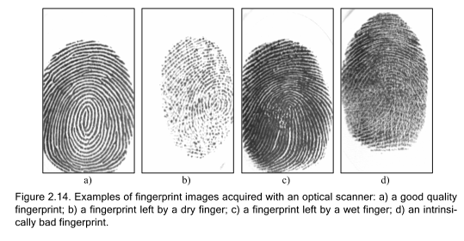
Condition-dependent quality
Faculty of Engineering Sciences, ESAT-PSI

Slide 24
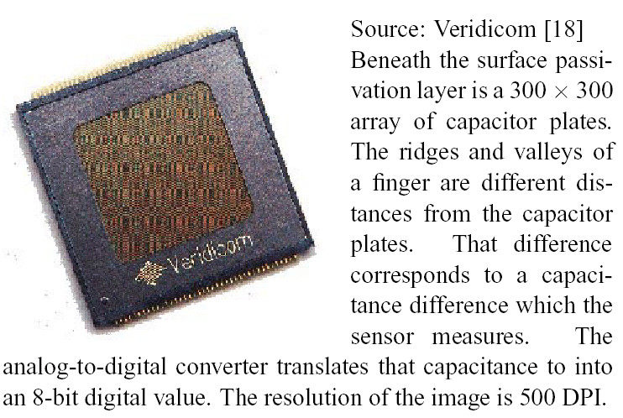
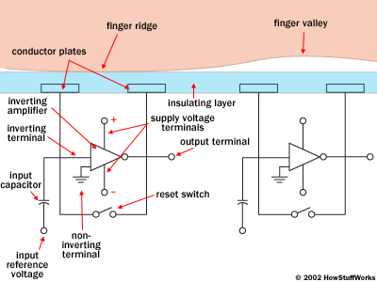
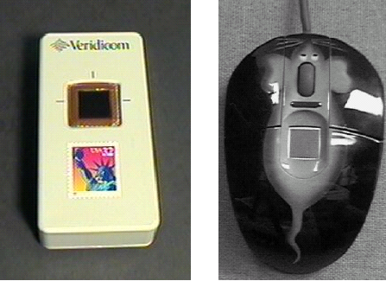
Live-scan FP acquisition: Differential Capacitance
Notes:
[Jain & Pankanti:]
CMOS capacitance [17]: The ridges and valleys of a finger create different charge accumulations when
the finger touches a CMOS chip grid. With suitable electronics, the charge is converted to a pixel value.
Normally at 500 dpi these scanners provide about 0.5” 0.5” of scan area. This can be a problem as the
two images acquired at two different times may have very little overlap. They also tend to be affected by
the skin dryness and wetness. In addition, these devices are sensitive to electrostatic discharge.

Slide 25
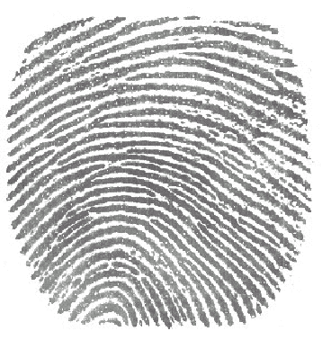
Differential Capacitance
- small surface area: 15x15 mm
+ compact
+ durable and easy to integrate
+ good resolution 500 dpi
+ liveness detection
+ difficult to fool
+ minimal power consumption
+ fast
+ low cost
- sensitive to electrical discharges
Ó Precise Biometrics
300x300, 8-bit

Slide 26
Live-scan FP acquisition: Ultrasound
Independent of moisture
Independent of dust (cf. infra)
Expensive (2500 Euro)
Bulky still (15x15x20cm)
High Resolution (up to 1000dpi)
3D
Ó Ultra-Scan

Slide 27
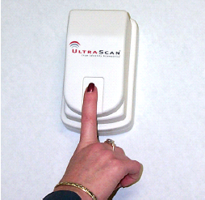
From bulky to under-glass …
Samsung Galaxy S10
@AndroidAuthority
Faculty of Engineering Sciences, ESAT-PSI

Slide 28
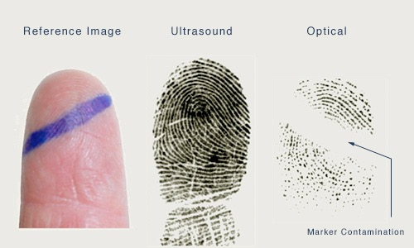
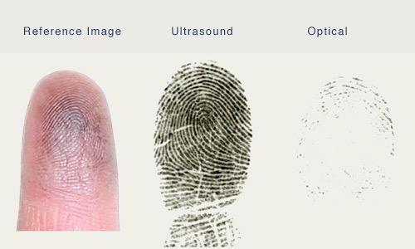
Ultrasound vs. Optical
Ó Ultra-Scan

Slide 29
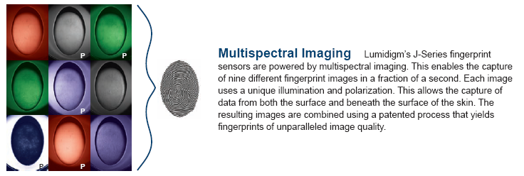
MultiSpectral Fingerprint Acquisition

Slide 30
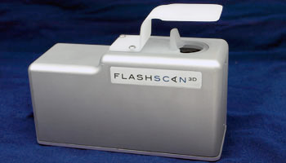
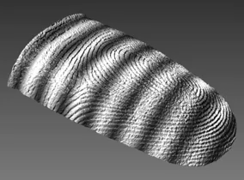
3D Touchless FP acquisition
Improved Quality
Additional Challenge: 3D/2D matching
www.flashscan3d.com
http://www.vis.uky.edu/~realtime3d/Research/Fingerprint.htm
http://www.tbs-biometrics.com

Slide 31

MorphoWave Desktop
Faculty of Engineering Sciences, ESAT-PSI

Slide 32
Touchless (3D) optical scanner
MorphoWave Desktop by IDEMIA scans and processes simultaneously four fingerprints with a single hand movement over its large contactless scanning surface.
This sequence lasting less than a second, MorphoWaveDesktop is then capable of enrolling all 10 fingerprints (2 slaps* and 2 thumbs) in under 5 seconds.
In addition, the 3D technology captures more than just ridges but also surface, shape and curvature of fingers, resulting in a 20%+ higher hit rate than any competing solution (based on an independent study) and a proven compatibility with standard flat and rolled fingerprint databases and AFIS systems.
MorphoWave Desktop copes with wet and dry fingers, mitigates hygiene concerns and is robust against external light and dust.
Faculty of Engineering Sciences, ESAT-PSI

Slide 33
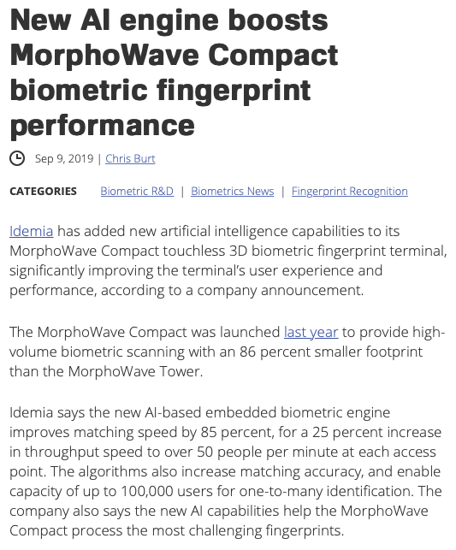
Touchless (3D) optical scanner
https://www.idemia.com/morphowave-desktop
https://www.biometricupdate.com/201909/new-ai-engine-boosts-morphowave-compact-biometric-fingerprint-performance
Faculty of Engineering Sciences, ESAT-PSI

Slide 34
Live Fingerprints Acquisition Devices
Reference (area, resolution, contrast): inked fingerprints
Optical FTIR (!) (bulky, best quality, large area, expensive)
Differential capacitance (cheap, small, lower Q)
Ultrasound TIR (bulky, quality, small area)
Thermal sensing of temperature differential across ridges and valleys
Non-contact 3-D scanning
See this page (and) for the latest developments and technology comparison
Notes:
[Jain & Pankanti:]
CMOS capacitance [17]: The ridges and valleys of a finger create different charge accumulations when
the finger touches a CMOS chip grid. With suitable electronics, the charge is converted to a pixel value.
Normally at 500 dpi these scanners provide about 0.5” 0.5” of scan area. This can be a problem as the
two images acquired at two different times may have very little overlap. They also tend to be affected by
the skin dryness and wetness. In addition, these devices are sensitive to electrostatic discharge.
Thermal [21]: The pyro-electric material in the sensor measures temperature changes as the finger is
swiped over the scanner and produces an image. This technology is claimed to overcome the dry and wet
skin issues in the optical scanners and can sustain higher static discharge. However, the images are not
rich in gray values.
Ultrasound [5]: An ultrasonic beam is scanned across the fingerprint surface to measure the ridge depth
from the reflected signal. Skin conditions such as dry, wet and oil on the skin do not affect the imaging
and the images better reflect the actual ridge topography. However, these units tend to very bulky and
require larger scanning time than the optical scanners.
Recently non-contact [2] fingerprint scanners have been announced to avoid problems related touching a surface for scanning the fingerprint.

Slide 35
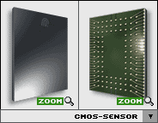
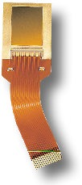
Fingerprint Recognition: Sensors (I)
Electro-optical sensor
[DELSY® CMOS sensor modul]
Optical fingerprint sensor
[Fingerprint Identification Unit FIU-001/500 by Sony]
Capacitive sensor
[FingerTIP™ by Infineon]
© Scarlet Schwiderski-Grosche
Scarlet.Schwiderski-Grosche@rhul.ac.uk
Notes:
The sensors by DELSY and Infineon are chip-based.
A picture of an ultrasound fingerprint sensor [by UltraScan] was not available.

Slide 36
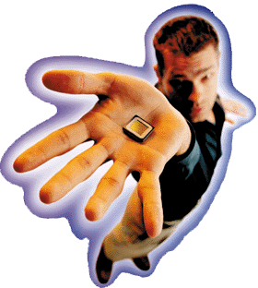
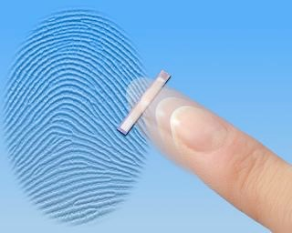
Fingerprint Recognition: Sensors (II)
Thermal sensor
[FingerChip™ by ATMEL (was: Thomson CSF)]
E-Field Sensor
[FingerLoc™ by Authentec]
© Scarlet Schwiderski-Grosche
Scarlet.Schwiderski-Grosche@rhul.ac.uk
Notes:
The sensor by Authentec is chip-based.

Slide 37
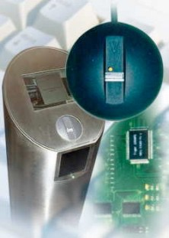
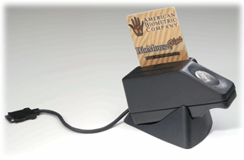
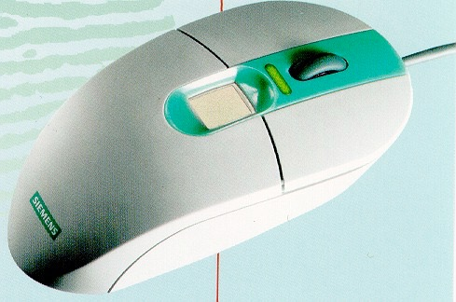
Fingerprint Recognition: Integrated Systems (I)
[BioMouse™ Plus by American Biometric Company]
Physical Access Control System
[BioGate Tower by Bergdata]
[ID Mouse by Siemens]
© Scarlet Schwiderski-Grosche (Scarlet.Schwiderski-Grosche@rhul.ac.uk)
Notes:
BioMouse™ Plus:
integrated smartcard reader and fingerprint sensor
ID Mouse:
mouse with fingerprint sensor

Slide 38
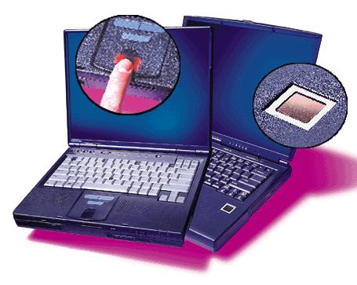
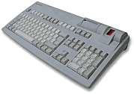
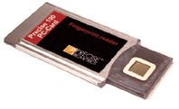
Fingerprint Recognition: Integrated Systems (II)
[TravelMate 740 by Compaq und Acer]
Keyboard [G 81-12000
by Cherry]
Precise 100 PC-Card by Precise Biometrics
© Scarlet Schwiderski-Grosche
Scarlet.Schwiderski-Grosche@rhul.ac.uk
Notes:
Cherry keyboard:
with integrated smartcard reader and fingerprint sensor

Slide 39
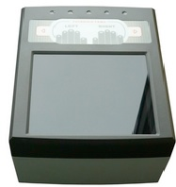
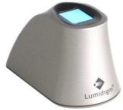
Advanced fingerprint scanners
Futronic FS60 EBTS/F Certified ID Flat -USB multi finger fingerprint scanner (1900$)
Lumidigm Mercury Series M301 Fingerprint Reader - USB multi-spectral fingerprint scanner (200$)

Slide 40

Touch ID (Apple)
Capacitance Sensor, 500 DPI

Slide 41


Fingerprint Representation
Faculty of Engineering Sciences, ESAT-PSI

Slide 42
FP Representation
Which machine-readable representation completely captures the
invariant (low intra-class variations) and
discriminatory (high-inter-class variation)
information in a fingerprint image?
Constitutes essence of fingerprint verification system design!
Properties
Saliency
contains distinctive information
Suitability
Easily extractable
Compact storage
Useful for matching

Slide 43

Structural characteristics: ridges and valleys
Ridge/valley width: 100-300µm
Faculty of Engineering Sciences, ESAT-PSI

Slide 44

Representational levels L0-L3
Faculty of Engineering Sciences, ESAT-PSI

Slide 45
Representation L0: Entire Gray Scale Profile
Used in optical matching
Verification by template matching
Limitations due to:
Brightness variations
Image quality variations
Scars
Large global distortions
Representation size is large

Slide 46


Representation L1: global ridge flow pattern
Only ridge flow and ridge frequency are coded
Singular regions
Delta (△-shape)
Loop (⌒-shape)
Whorl (O-shape)
Used for classification

Slide 47


Representations: Entire ridge structure
Image (or graphical coding) of binary image of ridges
Invariant to brightness variations
Sensitive to fingerprint image quality

Slide 48

Representation L2: Landmark Features - minutiae
local invariant ridge discontinuities, called minutiae
Defined by Sir Francis Galton (1892)!
$ ±150 different types of local ridge structures.

Slide 49

L2: Landmark Features - minutiae
local ridge discontinuities, called minutiae
$ ±150 different types of local ridge structures.
Difficult to automatically, quickly and reliably extract (too similar and image quality dependent).
Typically: representation based on 2 most prominent:
Ridge endings and ridge bifurcations (are in fact background-foreground duals) or minutiae.

Slide 50


Minutiae example
Difficult to automatically, quickly and reliably extract (too similar and image quality dependent).
Density: 100/FP but only 10 to 15 needed for matching
In practice only ridge bifurcations and endings are used

Slide 51

L2 Minutiae Representation
List of minutiae coordinates
Enhanced by tagging each minutiae (or pairs, triplets) with:
Orientation of the ridge at that minutiae
Ridge density (# ridges on a line) between each pair of minutiae
Enhanced by global attributes:
Global orientation of the finger
Locations of cores or delta’s
Fingerprint class

Slide 52


Representation L3 Representations: Pores
Pores are formed where sweat glands in the subcutaneous layer of the skin generate sweat ducts;
these sweat ducts grow through the subcutaneous layer and dermis to the epidermis, where the
open duct on the skin’s surface presents itself as a pore

Slide 53

Pores
The regularity of their appearance plays a significant part in the uniqueness of pore configurations.
Once these pores form on the ridge, they are fixed at that location.
Pores do not disappear, move or spontaneously generate over time.
Pore sizes: 60-250μm (Ridges: 100-300μm).
Pore density: ±6 pores/mm^{2.}
High resolution sensors needed: 1000dpi (compared to standard 500dpi of FBI’s AFIS specifications).

Slide 54

Fingerprint Enhancement
Faculty of Engineering Sciences, ESAT-PSI

Slide 55

Image Degradation
Non-uniform illumination, dirt, latent prints, scars
Wet finger
Dry finger
Wrinkle

Slide 56


FP image degradation
Faculty of Engineering Sciences, ESAT-PSI

Slide 57


FP image degradation
Types of degradation associated with FP images:
The ridges are not strictly continuous; that is, the ridges have small breaks (gaps).
Parallel ridges are not well separated. This is due to the presence of noise which links parallel ridges, resulting in their poor separation.
Cuts, creases, and bruises on the finger.
This leads to the following problems in minutiae extraction:
a significant number of spurious minutiae are extracted
a large number of genuine minutiae are missed
large errors in the location (position and orientation) of minutiae are introduced.
Faculty of Engineering Sciences, ESAT-PSI

Slide 58

FP image enhancement
Faculty of Engineering Sciences, ESAT-PSI

Slide 59
Fingerprint Enhancement

Slide 60

Enhancement: global enhancement
Contrast stretching, Histogram normalization (e.g. standard μ, σ)

Slide 61


Enhancement: local adaptive/matched filtering
In contextual filtering, the filter characteristics change according to the local context.
In FP enhancement, the context is defined by the local ridge orientation and local ridge frequency.
An appropriate matched filter that is tuned to the local ridge frequency and orientation can efficiently remove the undesired noise and preserve the true ridge and valley structure.
The intended behaviour :
provide a low-pass (averaging) effect along the ridge direction with the aim of linking small gaps and filling impurities due to pores or noise;
perform a bandpass (differentiating) effect in the direction orthogonal to the ridges to increase the discrimination between ridges and valleys and to separate parallel linked ridges.
Using a bank of frequency and orientation selective Gabor filters
Faculty of Engineering Sciences, ESAT-PSI

Slide 62



Enhancement: local adaptive filtering
Using a bank of frequency and orientation selective filters

Slide 63

FP enhancement using bank of Gabor Filters

Slide 64


Slide 65

Enhancement: examples

Slide 66
Enhancement: examples

Slide 67
Fingerprint Compression
Faculty of Engineering Sciences, ESAT-PSI

Slide 68

Fingerprint Image Compression
IAFIS (FBI,1995): 200 million FP cards (10 fingers)
Each FP cars scanned at 500dpi: 10MByte
Making 2000 Terabyte in total (1995)
Adding 30.000-50.000 cards A DAY!
Need for compression!
Wavelet Scalar Quantization (WSQ) LOSSY compression (FBI standard for the compression of 500 dpi fingerprint images)

Slide 69

Fingerprint Image Compression
the central section of a fingerprint image scanned at 500 dpi resolution
the marked portion of the image in a)
the marked portion of the image in a) after the image was compressed using JPEG
the marked portion of the image in a) is shown after the image was compressed using the WSQ compression algorithm.
Both JPEG and WSQ examples used a compression ratio of 1:12.9;
JPEG typically introduces blocky artifacts and obliterates detailed information.
Images courtesy of Chris Brislawn, Los Alamos National Laboratory.
Faculty of Engineering Sciences, ESAT-PSI

Slide 70

Fingerprint Image Compression
Original image; file size 589824 bytes

Slide 71

Fingerprint Image Compression
JPEG image; file size 45853 bytes,compression ratio 12.9.

Slide 72

Fingerprint Image Compression
WSQ image; file size 45621 bytes, compression ratio 12.9.

Slide 73
Fingerprint Image Compression
Original image; file size 589824 bytes

Slide 74
Fingerprint classification
Faculty of Engineering Sciences, ESAT-PSI

Slide 75


Fingerprint Classification
Arch
Tented arch
Right loop
Arch
Tented arch
Right loop
Left loop
Whorl
Twin loop
Left loop
Whorl
Twin loop

Slide 76
Fingerprint Classification
Core = topmost point in innermost ridge
Delta = tri-radial point with three ridges radiating from it

Slide 77


Fingerprint Classification
Direction field
Smooth Direction field (till classification succeeds)
Locate Singular Points:
Poincare Index = summing up the changes in direction angle around a closed curve around a point

Slide 78

Biometrics System Concepts (Course HJ59, K.U.Leuven) – D. Vandermeulen – Fingerprint Recognition

Slide 79
FP feature extraction
Faculty of Engineering Sciences, ESAT-PSI

Slide 80

Representation L1 Ridge (frequency, orientation) extraction
Faculty of Engineering Sciences, ESAT-PSI

Slide 81


Orientation Field Estimation
Divide the input fingerprint image into non-overlapping blocks of size WxW (e.g. 16x16)
Compute the gradients G_{x} and G_{y} at each pixel in each block
Estimate the (optimal in the least squares sense) local orientation at each pixel [i,j] using the following equations:

Slide 82



Orientation Field Estimation (2)
Hierarchical re-estimation based on consistency level of the orientation field in the local neighborhood of a block with the following formula:
D represents the local neighborhood (e.g. 5x5) around the block (i, j); N is the number of blocks within D; q(i’,j’) and q(i,j) are local ridge orientations at blocks (i’,j’) and (i,j), respectively.
Biometrics System Concepts (Course HJ59, K.U.Leuven) – D. Vandermeulen – Fingerprint Recognition

Slide 83

Orientation Field Estimation

Slide 84


Ridge Detection
Gray level values in ridges attain local maxima along direction normal to the local ridge orientation
or
Maximum along one of the principal curvatures and zero other principal curvature
ideal
Real fingerprint detail

Slide 85
Ridge Detection
original
Ridge
Thinned
Cleaned:
remove spikes
join broken ridges

Slide 86
Representation L2 Minutiae extraction
Faculty of Engineering Sciences, ESAT-PSI

Slide 87


Minutiae Detection (1)
Minutiae extracted from ridge image
Trivial if ridge image perfect
Notes:
[From the home page of CESENA]
Most automatic systems for fingerprint comparison are based on minutiae matching. Minutiae are essentially terminations and bifurcations of the ridge lines that constitute a fingerprint pattern. Automatic minutiae detection is an extremely critical process, especially in low-quality fingerprints where noise and contrast deficiency can generate pixel configurations similar to minutiae or hide real minutiae. Several approaches to automatic minutiae extraction have been proposed: although rather different from one other, most of these methods transform fingerprint images into binary images through an ad hoc algorithm. The images obtained are submitted to a thinning process which allows for the ridge-line thickness to be reduced to one pixel.

Slide 88

Minutiae Detection (1)
Ridge image not perfect!
Extraction should degrade gracefully with quality

Slide 89

Minutiae Detection: Algorithm

Slide 90


Minutiae and Pores Detection (1a) Gray Scale to Binary Conversion

Slide 91

Minutiae and Pores Detection (1a) Binary to Skeleton Conversion

Slide 92

Minutiae and Pores Detection (1a) Skeleton Postprocessing

Slide 93

Minutiae and Pores Detection (1a) Cleaning and Pore Detection
Biometrics System Concepts (Course HJ59, K.U.Leuven) – D. Vandermeulen – Fingerprint Recognition

Slide 94

Minutiae and Pores Detection (1a) Results

Slide 95



Minutiae Detection
Let (x,y) denote a pixel on a thinned ridge
and N₀, …, N₇ its 8 neighbors

Slide 96

Minutiae filtering

Slide 97

Minutiae Detection: result

Slide 98
Minutiae Quality =f(preprocessing)

Slide 99

Minutiae Detection (2)
Minutiae detected directly from gray scale images
The basic idea of this method is to follow the ridge lines on the gray-scale image, by "sailing" according to the fingerprint directional image. The algorithm keeps following the ridge lines until they terminate or intersect other ridge lines (minutiae detection).
Notes:
[From the home page of CESENA]
In [D. Maio, D. Maltoni, "Direct Gray-Scale Minutiae Detection in Fingerprints", IEEE tPAMI, v. 19, no. 1, 1997] an original technique is proposed, based on ridge-line following, where the minutiae are extracted directly from gray-scale images.
The basic idea of this method is to follow the ridge lines on the gray-scale image, by "sailing" according to the fingerprint directional image. A set of starting points is determined by superimposing a square-meshed grid on the gray-scale image. For each starting point, the algorithm keeps following the ridge lines until they terminate or intersect other ridge lines (minutiae detection). A labeling strategy is adopted to examine each ridge-line only once and locate the intersections between ridge-lines.
The results achieved are compared with those obtained through some methods based on image binarization. In spite of a greater conceptual complexity, the method proposed performs better both in terms of robustness and efficiency (less than 0.2 sec. are necessary to extract all the minutiae from a 256x256 gray-scale image on a Pentium PC).

Slide 100

Minutiae Detection (2)

Slide 101
Fingerprint Matching
Faculty of Engineering Sciences, ESAT-PSI

Slide 102

Fingerprint Matching

Slide 103
Fingerprint Matching
Compare test and reference representation
define/calculate correspondence between features
define/calculate transformation (rigid/non-rigid)
define/calculate matching metric
define a threshold on acceptable matching
based on a model of the expected variations among the representations of mated pairs

Slide 104

Fingerprint Matching difficulties
Inconsistent mapping of 3-D shape of finger onto 2-D surface of glass platen
global translation, rotation, scaling (pressure), shear
local perturbations (small up to only connectivity preserving)
Non-uniform contact (skin dryness, sweat, dirt, humidity): ridges not in contact, valleys in contact, leading to spurious or missing minutiae
Irreproducible contact: injuries changing the ridge structure
Feature extraction artifacts
Additional acquisition artifacts (parallax distortion, previous fingerprint residues)

Slide 105




Matching Transformations
Euclidean (translation and rotation)
Similarity (Euclidean + scaling)
Affine (Similarity + shear)
Elastic (Affine + local, small, continuous perturbations)
Topological (connectivity preserving)?

Slide 106

Example

Slide 107
L2 (minutiae) matching
Faculty of Engineering Sciences, ESAT-PSI

Slide 108
Minutiae Matching
Reduces to point pattern matching
define/calculate correspondence
define/calculate transformation (rigid/non-rigid)
define/calculate matching metric
based on a model of the expected variations among the representations of mated pairs

Slide 109

Minutiae Matching
Reduces to point pattern matching
define/calculate correspondence
define/calculate transformation (rigid/non-rigid)
define/calculate matching metric
based on a model of the expected variations among the representations of mated pairs

Slide 110

Minutiae Matching
Strategies
Point Set (with attached attributes) Matching
Graph-matching
sub-graph isomorphism
Optimisation
relaxation
simulated annealing
genetic algorithms
Coping with
poor quality data
large databases
geometrical and structural distortion

Slide 111
Intra-class variations
Displacement: 2 mm ~ 40 pixels at 500 dpi
Rotation: +- 20 degrees
Partial overlap (especially important for small-area sensors
Non-linear distortion (skin plasticity)
Pressure and skin condition (dryness,sweat,dirt, grease, air humidity)
Noise (e.g. residues from previous fingerprints)
Feature extraction errors

Slide 112

Intra-class variations

Slide 113
Minutiae Matching
Alignment/Registration
Minutiae Pairing/Correspondence
Matching score computation

Slide 114


Minutiae Matching

Slide 115


Minutiae Pairing

Slide 116


Alignment

Slide 117


Matching
Find “best” Rigid Transform (θ,Δx,Δy) between minutiae points P and Q
= Point Pattern Matching!

Slide 118

Alignment
Find “best” Similarity Transform (s,θ,Δx,Δy) between minutiae points P and Q

Slide 119

Alignment
“Best” = #{overlapping and matching (same orientation) minutiae points} is maximal
Found using generalized Hough Transform
Uses Accumulator Array A with A(k,l,m,n) counting the evidence for F_{s,θ,Δx,Δy}
For each pair (p,q) ∈ PxQ find all possible transformations F_{s,θ,Δx,Δy} that map p to q:
∀ (s_{k},θ_{l}): ∃! (Δx,Δy): F_{s,θ,Δx,Δy} (p) = q
Δx,Δy quantized in bins

Slide 120

Alignment

Slide 121
Alignment improvements
Increment neighboring bins as well
Take directions of minutiae into account: increment only if minutiae direction at p when rotated by θ_{l} is the same (or about) as the direction in q
Result:

Slide 122
Minutiae Pairing

Slide 123

Alignment (2)
Make use of direction and ridge information

Slide 124

Alignment (2)
Calculate alignment as the similarity transformation that optimally (least squares sense, e.g.) maps the best “correlating” minutiae pair

Slide 125

Minutiae Matching
Alignment/Registration
Minutiae Pairing/Correspondence
Matching score computation
Errors in localizing minutiae
nonlinear deformations
Elastic matching

Slide 126

Elastic Matching
Represent minutiae sets as a string in polar co-ordinates (around minutiae pair of maximal consistency): concatenate points in an increasing order of radial angle in polar coordinates
Match the strings with a dynamic programming algorithm, minimizing a cost function such as the “edit” distance C

Slide 127


String Matching
Biometrics System Concepts (Course HJ59, K.U.Leuven) – D. Vandermeulen – Fingerprint Recognition

Slide 128

Matching: result

Slide 129
Matching same FP
Matching score = 49

Slide 130

Matching different FPs
Matching score = 4

Slide 131

Minutiae and Pores Representation

Slide 132

Minutiae and Pores Matching
Maximum correlation
Orientation
Metric = correlation
Metric = #matching pores
=?
Metric = #matching minutiae
=(within position and orientation window)

Slide 133
L1 feature (ridge) matching
Faculty of Engineering Sciences, ESAT-PSI

Slide 134

Feature Space Correlation based matching
Enhancement

Slide 135


Feature Space Correlation based matching

Slide 136

Feature Space Correlation based matching

Slide 137


Feature Space Correlation based matching
Gabor Filtering along 8 orientations
Standard Deviation map
Ridge Feature map

Slide 138
Multilevel Classification and Matching
1. Determine Fingerprint Class (Arch, Loop, …)
2. Constrain further using ridge density (between cores and deltas)
3. Perform Minutiae based matching

Slide 139
Individuality of Fingerprints
Faculty of Engineering Sciences, ESAT-PSI

Slide 140
FP evaluation
Faculty of Engineering Sciences, ESAT-PSI

Slide 141

FVC’2000 Database
Biometrics System Concepts (Course HJ59, K.U.Leuven) – D. Vandermeulen – Fingerprint Recognition

Slide 142

FVC’2000 Results

Slide 143

FVC’2002

Slide 144


FVC’2004
Different (more difficult) databases

Slide 145



Slide 146

Comparison of Biometrics Technologies

Slide 147

Notes:
Editorial Reviews (from Amazon.com)
Book Info Reference on automatic fingerprint recognition providing in-depth coverage of the most recent advances and practices; including sensing, feature extraction and matching, synthetic fingerprint image generation, indexing, and multimodal systems. For biometric security professionals, researchers, developers, and systems administrators. Book Description With their proven individuality and stability over time, fingerprints continue to be the most widely used physiological characteristic in systems that automatically recognize a person's identity. This comprehensive and authoritative reference, written by leading international researchers, covers all critical aspects of fingerprint security systems and technology. It provides in-depth coverage of the most recent advances and practices: sensing, feature extraction and matching, synthetic fingerprint image generation, indexing, and multimodal systems. The Handbook of Fingerprint Recognition is an absolutely essential resource for all biometric security professionals, researchers, practitioners, developers, and systems administrators.
Features & Benefits:
*Covers the latest research in fingerprint-based recognition algorithms and techniques
*Provides introductory material on all components and modules of a fingerprint recognition system
*Examines design of secure fingerprint systems
*Contains helpful chapter overviews and summaries and consistent notation, for ease of use and accessibility
*Includes a DVD containing both the FVC2002 and FVC2000 fingerprint databases (full versions) and a demo version of SFinGe software (for synthetic fingerprint image generation)
*Integrates numerous supporting graphs, tables, charts, and performance data
*Supplies an extensive annotated bibliography of citations and literature sources

Slide 148
FP relevance
Faculty of Engineering Sciences, ESAT-PSI

Slide 149





Research & Development Projects
Dedicated sensor
Hot zone under-display
Large area under-display
Full under-display
Capacitive
Optical
Optical
Ultrasonic
Available since 2014
Ambition to enter the growing under-display market
Under development
Under development

Slide 150












Market potential for personal payment devices
1.5BN
6-8BN
100MN
30MN
40MN
Fingerprints™ estimates on shipments based on various industry sources
* Some of these tokens can be used for cryptocurrency, as well as authentication of online payment but more logical access

Slide 151


Biometric Smartcards – Fingerprints’ strengths
Strong experience in high-volume
production
Robust hardware and stable software
Offering biometric performance in a low computing power environment
Ultra-low power consumption
Strong collaboration with smartcard industry leaders
24

Slide 152

























Market potential for personal Access devices
60MN
40MN
50MN
10MN
225MN
60MN
100MN
900MN
7MN
15MN
50MN
200MN
Fingerprints™ estimates on shipments based on various industry sources
* Used for logical access and access to e.g. cryptocurrency

Slide 153



34%
33%
32%
32%
29%
29%
28%
28%
Unlocking PC Access car
Access the Register work Access the Verify Personalize
Making payments from PC
home time office
payments in car settings car

Slide 154


